Slide 1
Active learning-NLP
Learning how to Active Learn: A Deep Reinforcement Learning Approach
-Yunong

Slide 2
Short-comings of active learning and improvement (from the paper):
Heuristics are myopic
Learned selection, globally optimized
Inflexible, one-size-fits-all method
Deep neural network as selection function
Degenerate behaviors
Richer input representation, including instance itself
Seed data requirement to get started
Flexible framework, allows starting from scratch, or small model initialization
Notes:
select instance not useful

Slide 3
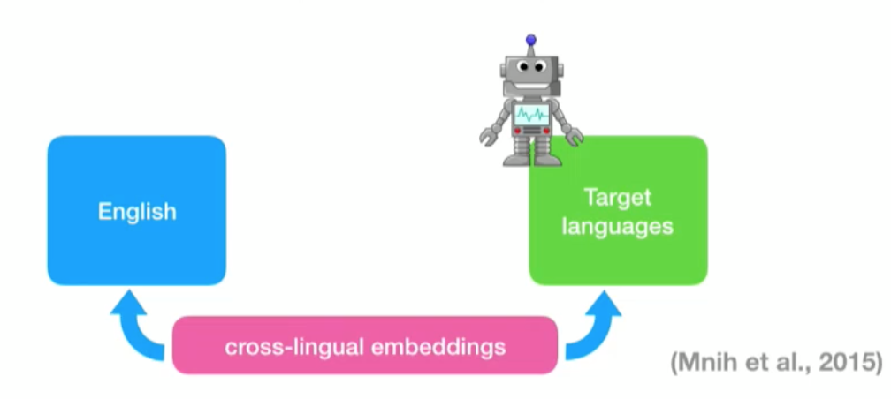
A novel formulation: PAL: policy based active learning
Deep reinforcement learning + transfer learning
Reframing the active learning as a reinforcement learning problem and explicitly learning a data selection policy, where the policy takes the role of the active learning heuristic
Importantly, the method allows the selection policy learned using simulation on one language to be transferred to other languages.
Using cross-lingual named entity recognition, observing uniform improvements over traditional active learning.
Notes:
Because of the low resource
Easy to learn a policy on a high resource language
Use cross-lingual word embeddings to learn compatible data epresentation for both languages

Slide 4
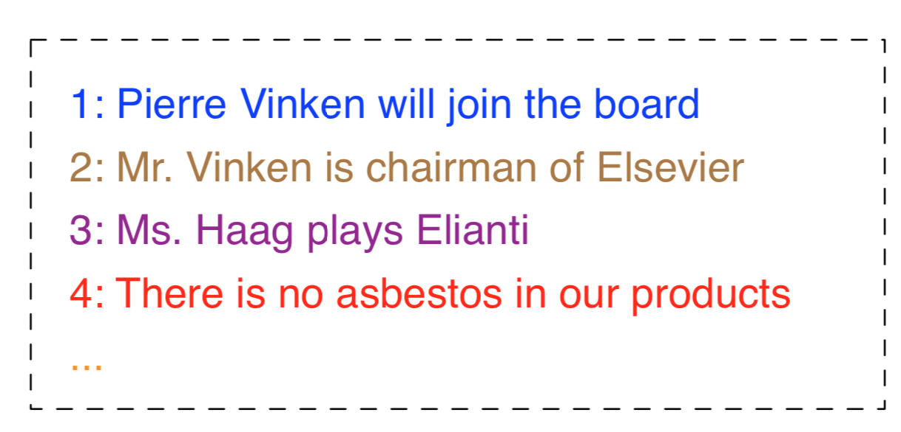
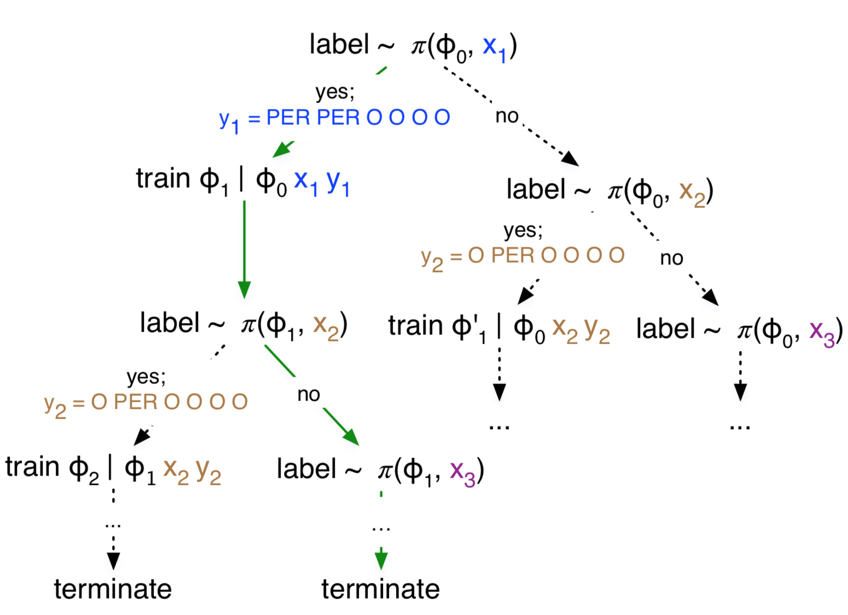
Active learning formalized as a decision process:
Represent the MDP framework as a tuple ⟨S, A, Pr(si+1|si, a), R⟩, where S = {s} is the space of all possible states, A = {0, 1} is the set of actions, R(s, a) is the reward function, and Pr(si+1|si, a) is the transition function.
Notes:
Example illustrating sequential active learning as a Markov Decision process.
Data arrives sequentially, and at each time the active learning policy, π, must decide whether it should be labelled or not, based on the state which includes a predictive model parameterized by φ, and an unlabeled data instance x. The process continues until termination, e.g., when the annotation budget is exhausted. The solid green path shows the maximum scoring decision sequence.

Slide 5
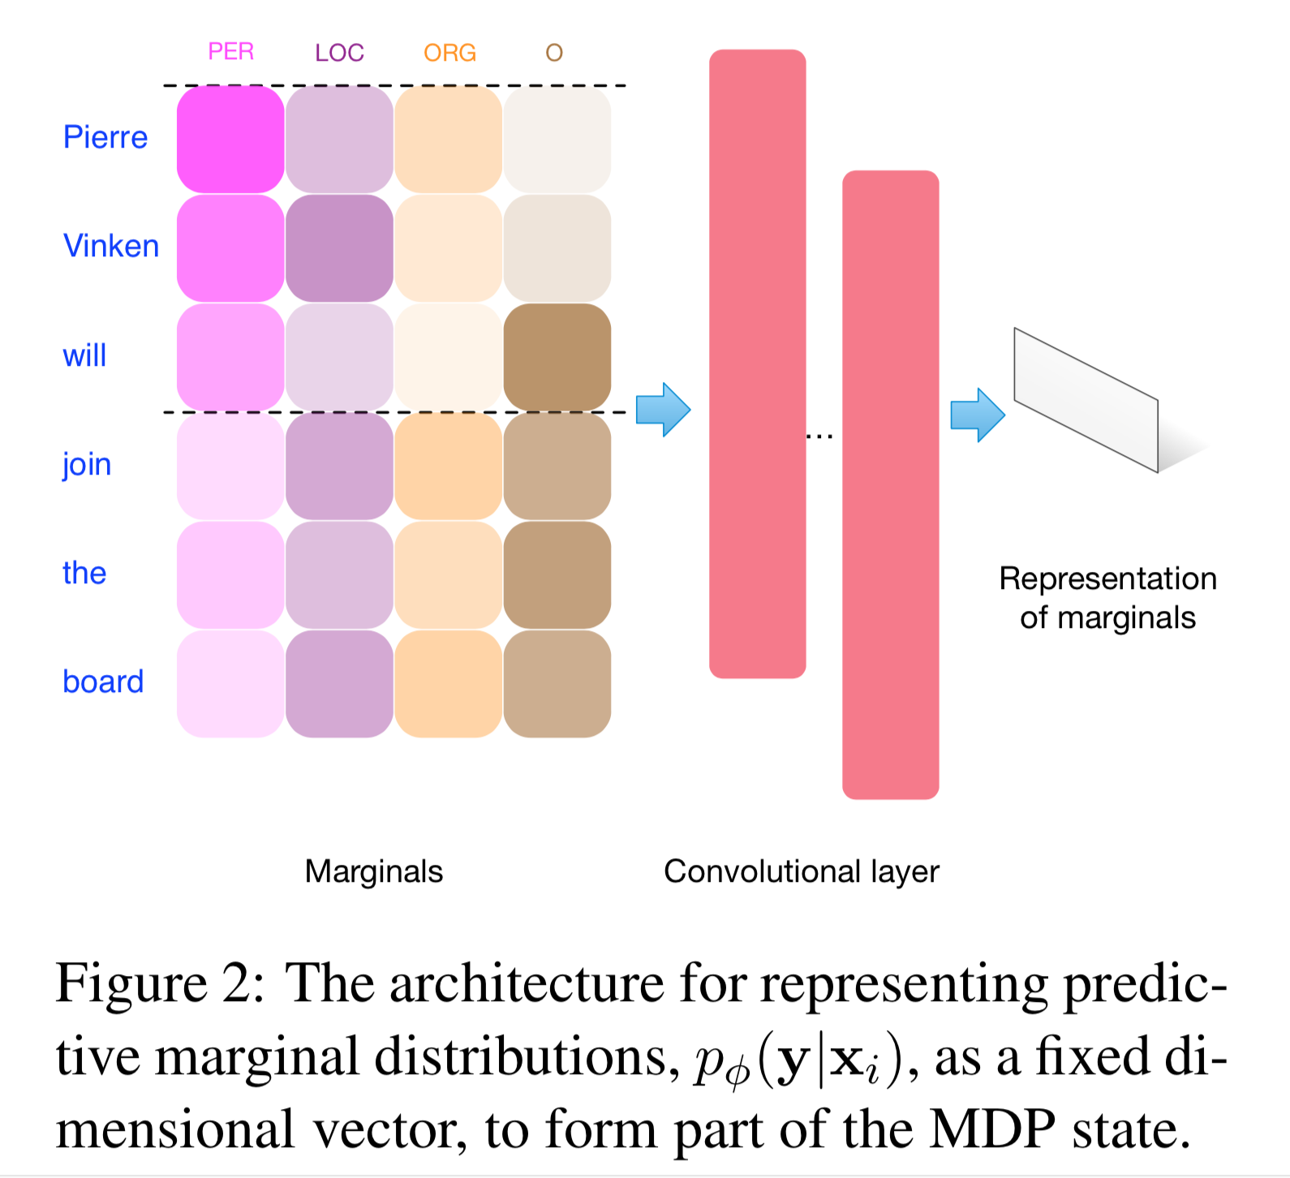
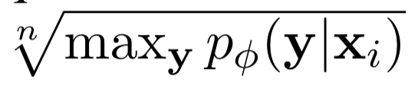
State representation:
Represent the state using a continuous vector
State = contents + marginals + confidence
Contents: vector representation of xi
cross-lingual embeddings + CNNs
Marginals: prediction distribution of the base CRF with CNN
Confidence: Viterbi scores under CRF
C =
where n = |xi| is the length of the sentence.
Notes:
conditional random fields

Slide 6
Action space:
Action = binary selection decision
The agent selects either to annotate xi, in which case ai = 1, or not, with ai = 0.
When ai = 1 is chosen, an oracle is requested to annotate the sentence, and the newly annotated sentence is added to the training data, and φ updated accordingly, train the new classifier
A special ‘terminate’ option applies when no further data remains or the annotation budget is exhausted

Slide 7
Reward signal:
Reward = performance difference
Return the performance improvement on a held-out dataset
Acc denotes predictive accuracy (here F1 score), and φi is the trained model after action a has take place.
The value of R(s, a) can be positive or negative, indicating a beneficial or detrimental effect on the performance.
https://en.wikipedia.org/wiki/F1_score
Notes:
F₁ score (also F-score or F-measure) is a measure of a test's accuracy. It considers both the precision p and the recall r of the test to compute the score: p is the number of correct positive results divided by the number of all positive results returned by the classifier, and r is the number of correct positive results divided by the number of all relevant samples (all samples that should have been identified as positive).

Slide 8
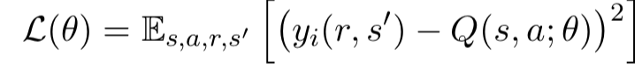
Policy learning via Q-learning:
Use deep neural network to compute the expected Q-value, in order to update the parameters
Deep Q-learning:
The parameters in the DQN are learnt using stochastic gradient descent, based on a regression objective to match the Q-values predicted by the DQN and the expected Q-values from the Bellman equation
Use an experience replay memory M to store each transition (s, a, r, s′) as it is used in an episode
Sample a mini-batch of transitions from the memory and then minimize the loss function:
Target q-value (bellman equation):
Training via backpropagation

Slide 9
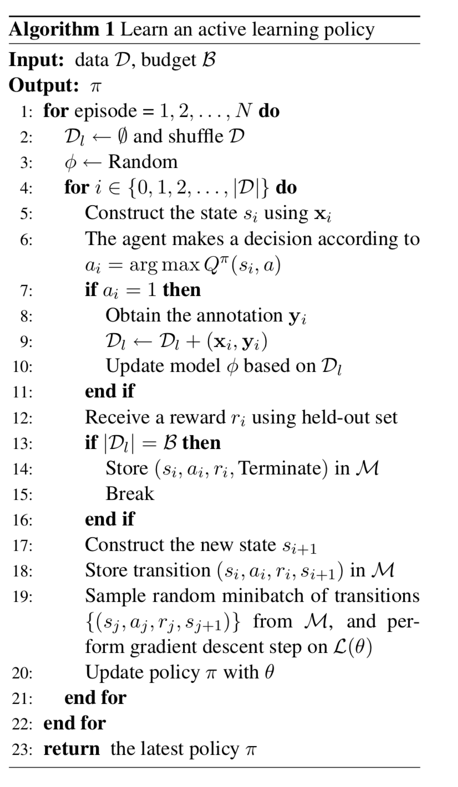


Ri is the discounted future reward and γ ∈ [0, 1] is a factor discounting the value of future rewards and the expectation is taken over all transitions involving state s and action a

Slide 10
Transfer the policy to another language:
Use cross-lingual word embeddings
A cross-lingual application of the same task (NER), where we train a policy on a source language (e.g., English), and then transfer the learned policy to a different target language
Cross-lingual word embeddings provide a common shared representation to facilitate application of the policy to other languages.
Standard setting:
Single test episode
Allow model updates
Allow policy updates using held-out
Cold-start setting:
Single test episode
No model updates
No policy updates

Slide 11
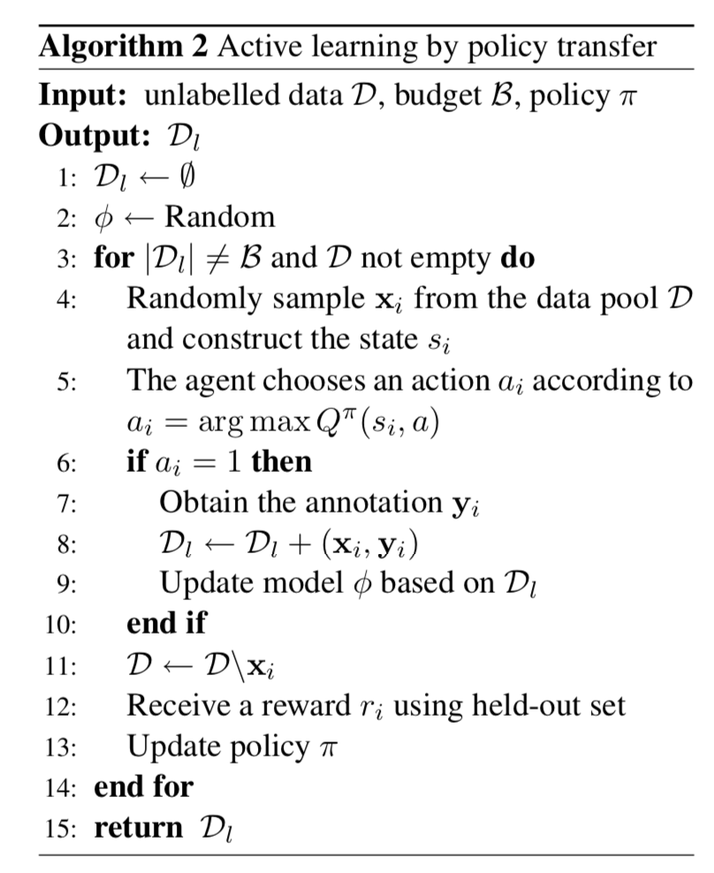
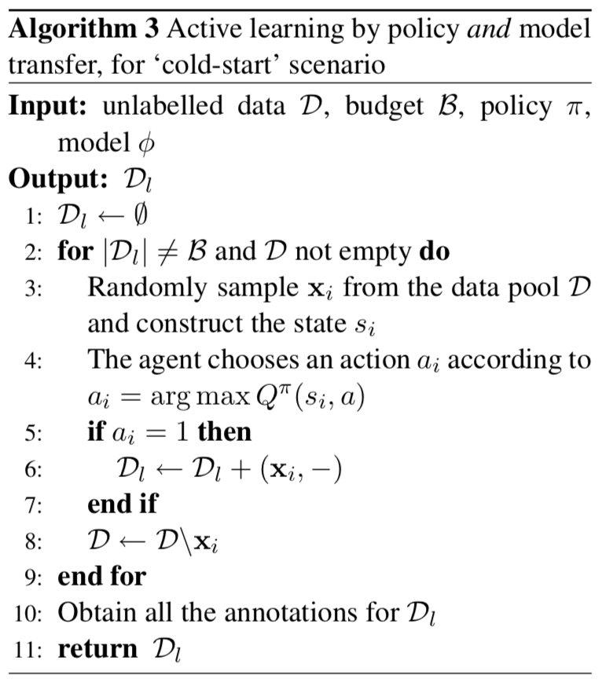
The model, φ, is trained on one source language, and the policy is learned on a different source language.
Notes:
Firstly, Algorithm 2 makes only one pass over the data, rather than several passes, as befits an application to a low-resource language where oracle labelling is costly. Secondly, the algorithm also assumes an initial policy, π, which is fine tuned during the episode based on held-out performance such that the policy can adapt to the test scenario.
Limitation: the requirement for held-out evaluation data and the embedding of the oracle annotator in- side the learning loop.
allow only one chance to request labels for the target data, and, having no held-out data, do not allow policy up- dates. The agent needs to select a batch of unlabeled target instances for annotations, but cannot use these resulting annotations or any other feed- back to refine the selection

Slide 12
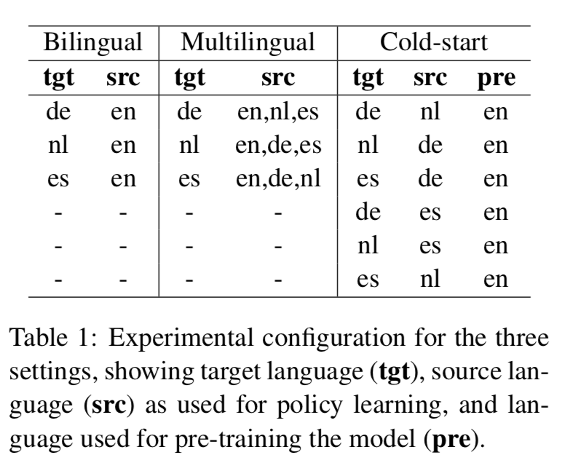
Experiment:
Data: NER corpora from CoNLL2002/2003 shared tasks
comprise NER annotated text in English (en), German (de), Spanish (es), and Dutch (nl)
Embeddings:
MultiCCA cross-lingual embeddings (Ammar et al., 2016)

Slide 13
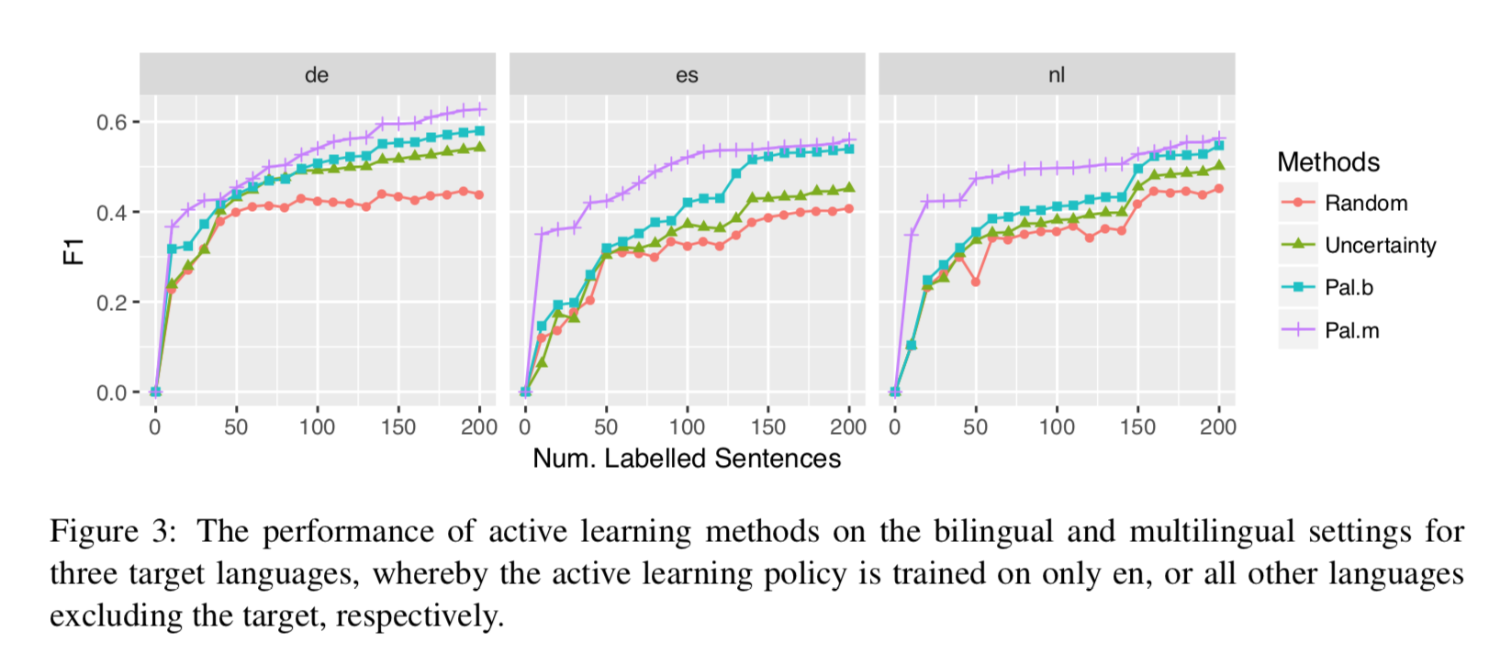
Standard active learning:

Slide 14
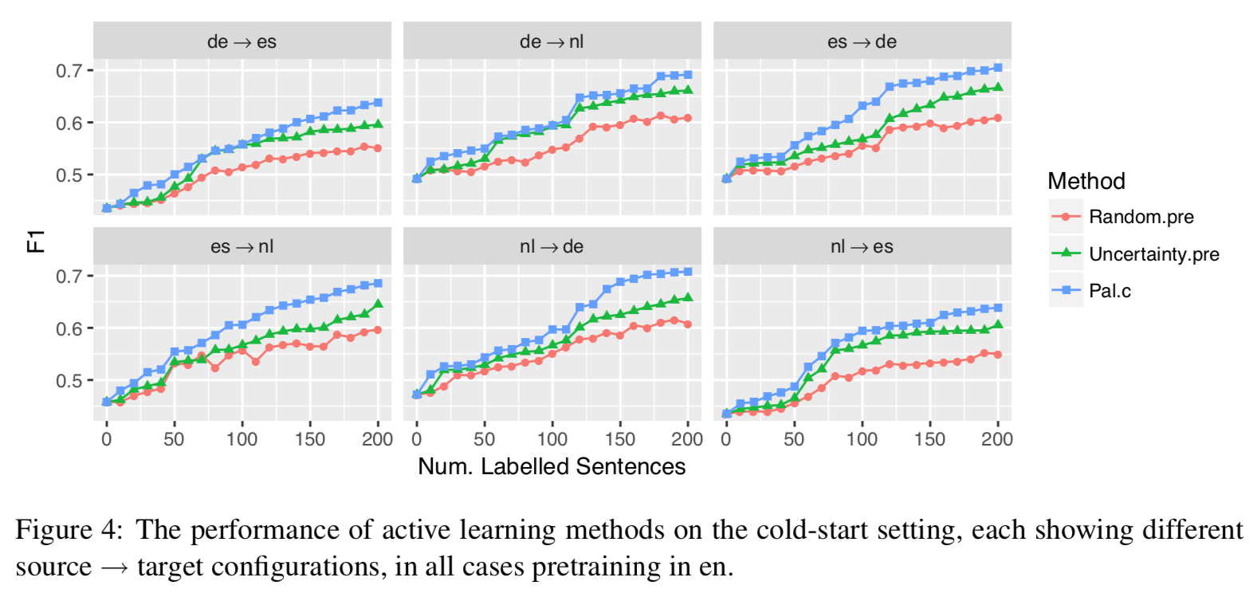
Cold start active learning:
Notes:
BiLSTM Bidirectional long short-term memory
BiLSTM means bidirectional LSTM, which means the signal propagates backward as well as forward in time.

Slide 15
Thanks!
Reference:
https://www.aclweb.org/anthology/D17-1063
https://github.com/mengf1/PAL
https://vimeo.com/238234005

